Slide 1
Managerial Economics and Financial Analysis
D. MAHESWARI
Assistant Professor
Department of Information Technology
Aditya Engineering College (A)
Email: Maheswari.dama@aec.edu.in

Slide 2
Law of Returns of Scale:
The law of returns to scale explains the behavior of the total output in response to change in the scale of the firm, i.e., in response to a simultaneous to changes in the scale of the firm, i.e., in response to a simultaneous and proportional increase in all the inputs. More precisely, the Law of returns to scale explains how a simultaneous and proportionate increase in all the inputs affects the total output at its various levels.

Slide 3
Types of returns to scale.
Increasing returns to scale
Constant returns to scale
Decreasing returns scale
Variable returns to scale

Slide 4
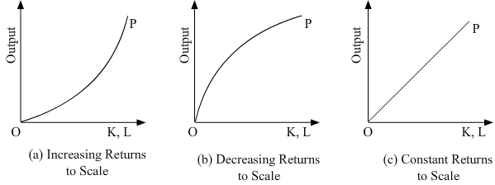

Slide 5
Increasing returns to scale
If increase in the output is greater than proportional increase in the inputs, it means increasing returns to scale.

Slide 6
Constant returns to scale
If increase in the total output is proportional to the increase in input, it means constant returns to scale.

Slide 7
Decreasing returns to scale
If increase in the output is less than proportional increase in the inputs, it means diminishing returns to scale.

Slide 8
Variable returns to scale
When a firm expands, its scale increases all its inputs proportionally, then technically there are three possibilities. (i) The total output may increase proportionately (ii) The total output may increase more than proportionately and (iii) The total output may increase less than proportionately.

Slide 9
Economies of scale
Production may be carried on a small scale or o a large scale by a firm. When a firm expands its size of production by increasing all the factors, it secures certain advantages known as economies of production. Marshall has classified these economies of large-scale production into
1.Internal economies and
2.External economies.

Slide 10
Internal economies: are those, which are opened to a single factory or a single firm independently of the action of other firms. They result from an increase in the scale of output of a firm and cannot be achieved unless output increases. Hence internal economies depend solely upon the size of the firm and are different for different firms.

Slide 11
External economies are those benefits, which are shared in by a number of firms or industries when the scale of production in an industry or groups of industries increases. Hence external economies benefit all firms within the industry as the size of the industry expands.

Slide 12
Causes of internal economies: Internal economies are generally caused by two factors
1. Indivisibilities
2. Specialization.

Slide 13
INTERNAL ECONOMIES: Internal economies may be of the following types. A). Technical Economies. Technical economies arise to a firm from the use of better machines and superior techniques of production. As a result, production increases and per unit cost of production falls. A large firm, which employs costly and superior plant and equipment, enjoys a technical superiority over a small firm. Another technical economy lies in the mechanical advantage of using large machines. The cost of operating large machines is less than that of operating mall machine

Slide 14
B). Managerial Economies: These economies arise due to better and more elaborate management, which only the large size firms can afford. There may be a separate head for manufacturing, assembling, packing, marketing, general administration etc. Each department is under the charge of an expert. Hence the appointment of experts, division of administration into several departments, functional specialization and scientific co-ordination of various works make the management of the firm most efficient.

Slide 15
Marketing Economies:
The large firm reaps marketing or commercial economies in buying its requirements and in selling its final products. The large firm generally has a separate marketing department. It can buy and sell on behalf of the firm, when the market trends are more favorable. In the matter of buying they could enjoy advantages like preferential treatment, transport concessions, cheap credit, prompt delivery and fine relation with dealers. Similarly it sells its products more effectively for a higher margin of profit

Slide 16
D). Financial Economies: The large firm is able to secure the necessary finances either for block capital purposes or for working capital needs more easily and cheaply. It can barrow from the public, banks and other financial institutions at relatively cheaper rates. It is in this way that a large firm reaps financial economies

Slide 17
E). Risk bearing Economies: The large firm produces many commodities and serves wider areas. It is, therefore, able to absorb any shock for its existence. For example, during business depression, the prices fall for every firm. There is also a possibility for market fluctuations in a particular product of the firm. Under such circumstances the risk-bearing economies or survival economies help the bigger firm to survive business crisis.

Slide 18
F). Economies of Research: A large firm possesses larger resources and can establish it‟s own research laboratory and employ trained research workers. The firm may even invent new production techniques for increasing its output and reducing cost

Slide 19
. G). Economies of welfare: A large firm can provide better working conditions in-and out-side the factory. Facilities like subsidized canteens, crèches for the infants, recreation room, cheap houses, educational and medical facilities tend to increase the productive efficiency of the workers, which helps in raising production and reducing costs.

Slide 20
EXTERNAL ECONOMIES: Business firm enjoys a number of external economies, which are discussed below:

Slide 21
A). Economies of Concentration: When an industry is concentrated in a particular area, all the member firms reap some common economies like skilled labour, improved means of transport and communications, banking and financial services, supply of power and benefits from subsidiaries. All these facilities tend to lower the unit cost of production of all the firms in the industry.

Slide 22
B). Economies of Information The industry can set up an information centre which may publish a journal and pass on information regarding the availability of raw materials, modern machines, export potentialities and provide other information needed by the firms. It will benefit all firms and reduction in their costs

Slide 23
. C). Economies of Welfare: An industry is in a better position to provide welfare facilities to the workers. It may get land at concessional rates and procure special facilities from the local bodies for setting up housing colonies for the workers. It may also establish public health care units, educational institutions both general and technical so that a continuous supply of skilled labour is available to the industry. This will help the efficiency of the workers.

Slide 24
D). Economies of Disintegration: The firms in an industry may also reap the economies of specialization. When an industry expands, it becomes possible to spilt up some of the processes which are taken over by specialist firms. For example, in the cotton textile industry, some firms may specialize in manufacturing thread, others in printing, still others in dyeing, some in long cloth, some in dhotis, some in shirting etc. As a result the efficiency of the firms specializing in different fields increases and the unit cost of production falls. Thus internal economies depend upon the size of the firm and external economies depend upon the size of the industry.

Slide 25
set-A | Set-b
The locus of different combination of two input factors is known as---------- | External economies of scale
If two inputs are perfectly substituted ------iso quants are formed | Iso quants
In case of 1 chasis and 4 wheels ofinputs ------ iso quants are formed | Right angle iso quants
MRTS =4/1.What it indicates | Linear iso quants
Consumer equilibrium is attained at ------------ | At least cost combination of input factors
Producer equilibrium is attained at------------ | Maximum satisfaction
One large company produces different products what type of economies it has | Risk bearing economies
When a company acquire finance at less cost,It has--------economies | 4 units of capital is subtituted by one unit of labour
---------economies enjoyed by all the firms in industry | Financial economies of scale

Slide 26
Cost Analysis:
Profit is the ultimate aim of any business and the long-run prosperity of a firm depends upon its ability to earn sustained profits. Profits are the difference between selling price and cost of production.

Slide 27
COST CONCEPTS:
A managerial economist must have a clear understanding of the different cost concepts for clear business thinking and proper application. The several alternative bases of classifying cost and the relevance of each for different kinds of problems are to be studied. The various relevant concepts of cost are

Slide 28
Opportunity costs and outlay costs:
Out lay cost also known as actual costs obsolete costs are those expends which are actually incurred by the firm.
Ex: these are the payments made for labour, material, plant, building, machinery traveling, transporting etc., These are all those expense item appearing in the books of account, hence based on accounting cost concept.

Slide 29
opportunity cost
opportunity cost implies the earnings foregone on the next best alternative, has the present option is undertaken. This cost is often measured by assessing the alternative, which has to be scarified if the particular line is followed. The opportunity cost concept is made use for long-run decisions. This concept is very important in capital expenditure budgeting. This concept is very important in capital expenditure budgeting. The concept is also useful for taking short-run decisions opportunity cost is the cost concept to use when the supply of inputs is strictly limited and when there is an alternative. If there is no alternative, Opportunity cost is zero. The opportunity cost of any action is therefore measured by the value of the most favourable alternative course, which had to be foregoing if that action is taken.

Slide 30
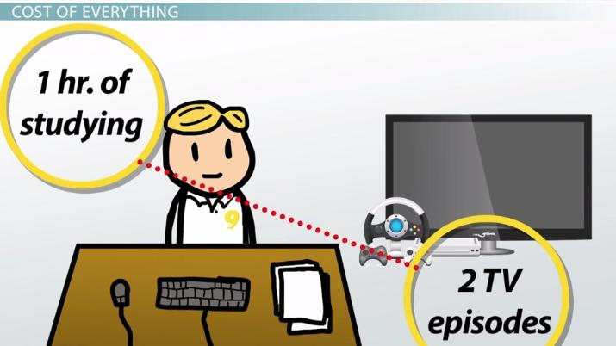

Slide 31
II. Explicit and implicit costs:
Explicit costs are those expenses that involve cash payments. These are the actual or business costs that appear in the books of accounts. These costs include payment of wages and salaries, payment for raw-materials, interest on borrowed capital funds, rent on hired land, Taxes paid etc.

Slide 32
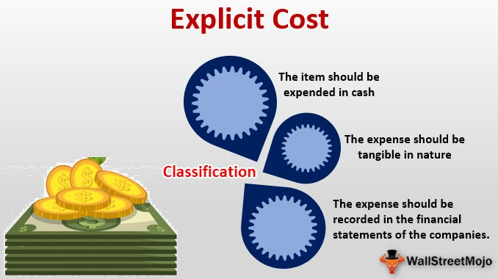

Slide 33
Implicit costs
Implicit costs are the costs of the factor units that are owned by the employer himself. These costs are not actually incurred but would have been incurred in the absence of employment of self – owned factors. The two normal implicit costs are depreciation, interest on capital etc. A decision maker must consider implicit costs too to find out appropriate profitability of alternatives

Slide 34
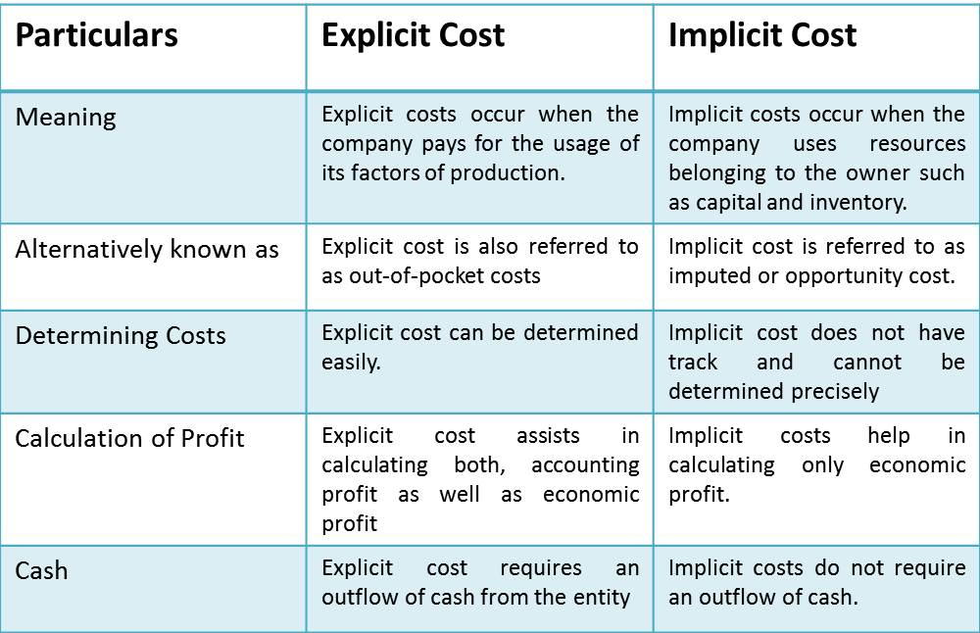

Slide 35
III. Historical and Replacement costs
Historical cost is the original cost of an asset. Historical cost valuation shows the cost of an asset as the original price paid for the asset acquired in the past. Historical valuation is the basis for financial accounts.

Slide 36
A replacement cost
A replacement cost is the price that would have to be paid currently to replace the same asset. During periods of substantial change in the price level, historical valuation gives a poor projection of the future cost intended for managerial decision. A replacement cost is a relevant cost concept when financial statements have to be adjusted for inflation.

Slide 37
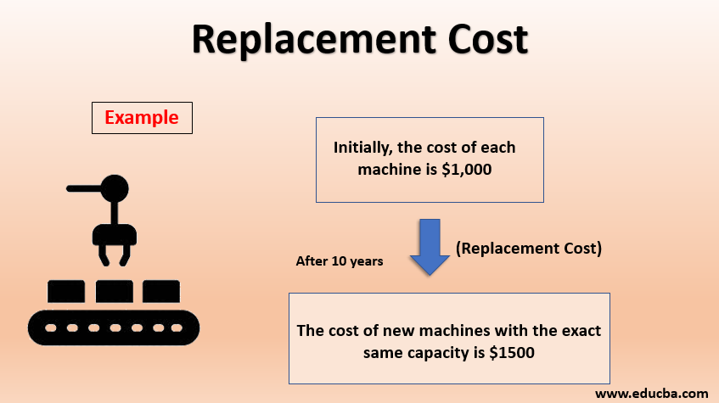

Slide 38
IV. Short – run and long – run costs:
Short-run is a period during which the physical capacity of the firm remains fixed. Any increase in output during this period is possible only by using the existing physical capacity more extensively. So short run cost is that which varies with output when the plant and capital equipment in constant.

Slide 39
Long run costs
Long run costs are those, which vary with output when all inputs are variable including plant and capital equipment. Long-run cost analysis helps to take investment decisions.

Slide 40
V Out-of pocket and books costs:
Out-of pocket costs also known as explicit costs are those costs that involve current cash payment.

Slide 41
Book costs
Book costs also called implicit costs do not require current cash payments. Depreciation, unpaid interest, salary of the owner is examples of book costs. But the book costs are taken into account in determining the level dividend payable during a period. Both book costs and out-of-pocket costs are considered for all decisions. Book cost is the cost of self-owned factors of production.

Slide 42
Fixed cost
Fixed cost is that cost which remains constant for a certain level to output. It is not affected by the changes in the volume of production. But fixed cost per unit decrease, when the production is increased. Fixed cost includes cost of land and buildings and furniture etc:

Slide 43
Variable Cot
Variable is that which varies directly with the variation is output. An increase in total output results in an increase in total variable costs and decrease in total output results in a proportionate decline in the total variables costs. Ex: Raw materials, labour, direct expenses, etc.

Slide 44
Past and Future costs:
Past costs also called historical costs are the actual cost incurred and recorded in the book of account these costs are useful only for valuation and not for decision making.

Slide 45
Future costs
Future are costs that are expected to be incurred in the futures. They are not actual costs. They are the costs forecasted or estimated with rational methods. Future cost estimate is useful for decision making because decision are meant for future.

Slide 46
Traceable and common costs:
Traceable costs otherwise called direct cost, is one, which can be identified with a products process or product. Raw material, labour involved in production is examples of traceable cost.

Slide 47
Common costs are the ones that common are attributed to a particular process or product. They are incurred collectively for different processes or different types of products. It cannot be directly identified with any particular process or type of product.

Slide 48
Avoidable and unavoidable costs:
Avoidable costs are the costs, which can be reduced if the business activities of a concern are curtailed. For example, if some workers can be retrenched with a drop in a product – line, or volume or production the wages of the retrenched workers are escapable costs.

Slide 49
The unavoidable costs are otherwise called sunk costs. There will not be any reduction in this cost even if reduction in business activity is made. For example cost of the ideal machine capacity is unavoidable cost.

Slide 50
Controllable and uncontrollable costs:
Controllable costs are ones, which can be regulated by the executive who is in charge of it. The concept of controllability of cost varies with levels of management. Direct expenses like material, labour etc. are controllable costs.

Slide 51
uncontrollable costs
Some costs are not directly identifiable with a process of product. They are appointed to various processes or products in some proportion. This cost varies with the variation in the basis of allocation and is independent of the actions of the executive of that department. These apportioned costs are called uncontrollable costs.

Slide 52
Incremental and sunk costs:
Incremental cost is the additional cost due to a change in the level or nature of business activity. The change may be caused by adding a new product, adding new machinery, replacing a machine by a better one etc.

Slide 53
Sunk costs are those which are not altered by any change – They are the costs incurred in the past. This cost is the result of past decision, and cannot be changed by future decisions. Investments in fixed assets are examples of sunk costs

Slide 54
Total, average and marginal costs:
Total cost is the total cash payment made for the input needed for production. It may be explicit or implicit. It is the sum total of the fixed and variable costs.
Average cost is the cost per unit of output. It is obtained by dividing the total cost (TC) by the total quantity produced (Q)

Slide 55
Marginal cost is the additional cost incurred to produce an additional unit of output or it is the cost of the marginal unit produced.

Slide 56
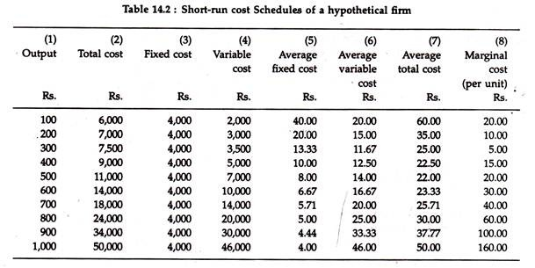

Slide 57
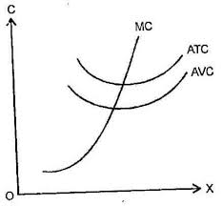
Average cost

Slide 58
Accounting and Economic costs:
Accounting costs are the costs recorded for the purpose of preparing the balance sheet and profit and loss statements to meet the legal, financial and tax purpose of the company. The accounting concept is a historical concept and records what was happened in the post.

Slide 59
Economics cost
Economic cost considers future costs and future revenues, which help future planning, and choice.
The accountant describes what was happened, the economics aims at projecting what will happen.

Slide 60
What happened to average cost when out put increases in short run | Rs.10
The cost of project is 2500000,it is an example of -------- cost | Variable cost
The earnings forgone due to sacrificing the next best alternative is called as----------- | Implicit cost
Cost of land and building is an example of -------------- | Un avoidable cost
Cost of raw materials is an example of -------------- | Avoidable cost
Unpaid rent is __________cost | Short run cost
Maintaining cost of idle cost of machinery is __________cost | Opportunity cost
Labour cost is __________cost | Out lay cost
The cost which varies along with out put is known as------------------ | Fixed cost
If fixed cost of ,firm is 2500000 what is fixed cost per unit?(the out put produced 250000. | decreases

Slide 61
Cost per single unit of | Out of pocket cost
The cost which is incurred due to sacrificing | When the business activity is curtailed is known as un avoidable cost
The alternative name of explicit cost is | Known as uncontrollable cost
The cost which can be reduced | by the owner is known as Explicit cost
The cost which is in the hands of executives to regulate is | remain constant is known as variable cost
The cost of the factors which are owned | Which is incurred to producing of an additional unit of out put is known as fixed cost
The cost which(constant) | The next best alternative is known as out cost
The additional cost | Out put is called as marginal cost cost

Slide 62
If out put produced is 25000 units from a machinery .the cost of machinery is 25000000,then fine fixed cost and AFC
If production cost of firm is 25 lakhs and it took a new decision of replacing machinery the total production cost becomes 50 lakhs. find incremental cost
From one project x is expecting 20 percent return with an investment of 250000.if he lend this money he will earn 15% return. shall we accept the project.

Slide 63
Thank you

